Slide 1

CS203-Database Systems
Mr. Faizad Ullah
Lecturer Computer Science

Slide 2
Grading Policy
Mid-exam I: 15%
Mid-exam II: 15%
Assignments/Quizzes/Presentations: 10%
Project: 10%
Final-exam: 50%

Slide 3
Textbook / Reference Materials
Textbook
Ramez Elmasri & Shamkant B. Navathe, Database Systems, Models, Languages, Design and Application Programming, 7th Edition, 2016.
Reference Materials
1) Thomas Connolly, Carolyn Begg, Database Systems: A practical approach to design, implementation and Management, 6th Edition, 2015.
2) C.J. Date, An Introduction to Database Systems, 8th Edition, 2004

Slide 4
Areas to be cover
Database design and application development
Concurrency and robustness
Efficiency and Scalability
Study of tools to manipulate databases

Slide 5
Database
Collection of well-organized, logically related data.
Traditional databases (textual, numeric)
Nontraditional databases (posts, voices, video clips, images)

Slide 6
Database Management System (DBMS)
Computerized system, enable users to create and maintain database.
Defining (meta-deta), constructing, manipulating, and sharing databases among various users and applications.
The database definition or descriptive information is also stored by DBMS.

Slide 7
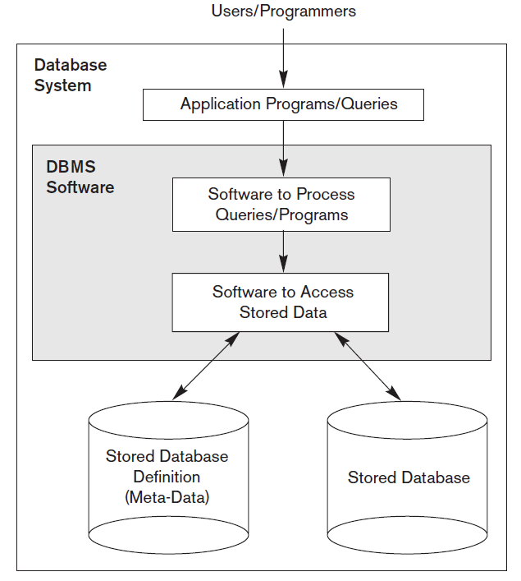
Database System
Figure 1.1 Database system environment

Slide 8
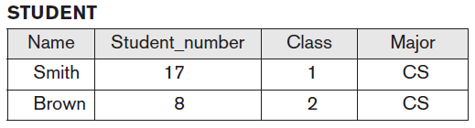
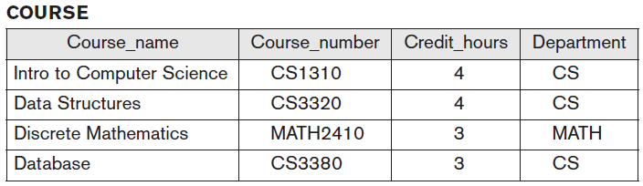
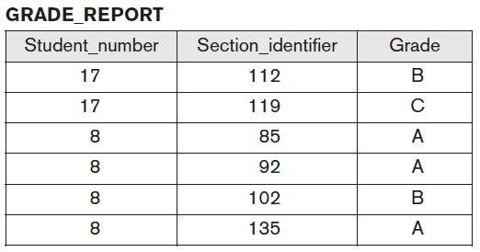
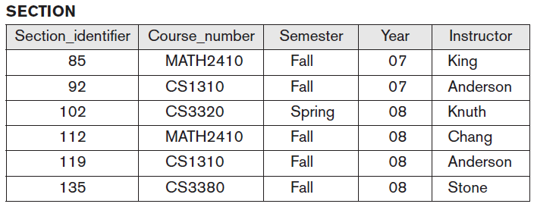
Example
University database for maintaining information concerning students, courses, faculty and grades in university environment.
Figure 1.2 A database that stores student and course information

Slide 9
File Processing System
The first computer-based approach to handle commercial or business applications.
Replacement of manual file system.
Manual file system
File processing system
DBMS

Slide 10
File Processing System cont...
Library
Examination
Registration
Library
Applications
Examination
Applications
Registration
Applications
Library
Data
Files
Examination
Data
Files
Registration
Data
Files
Figure 1.3 A typical file processing environment

Slide 11
File Processing System cont...
Disadvantages
Laborious
Time consuming
Inefficient
Data inconsistency
Data redundancy
Scalability issues etc.

Slide 12
Database System Environment
Library
Examination
Registration
Library
Applications
Examination
Applications
Registration
Applications
Database
Management
System
University
Students
Database
Figure 1.4 A typical Database System environment

Slide 13
DBMS Advantages
Controlling redundancy
Restricting Unauthorized Access
Efficient Query Processing
Providing Backup and Recovery
Providing Multiple User Interfaces
Enforcing Integrity Constraints
Permitting Inferencing and Actions Using Rules and Triggers

Slide 14
Assignment#1
“A Brief History of Database Applications”
Limit: >100 words <250 words
Note: I will check the similarity (plagiarism), also intra-class similarity.

